Slide 1
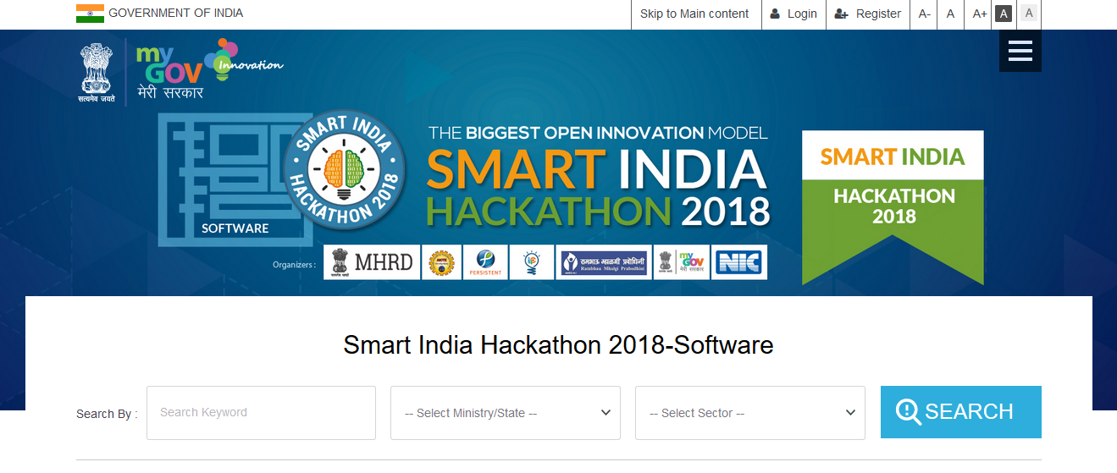
Problem statement :
Identification of meritorious students in primary education
Submitted by :
DIGINDIA

Slide 2
Vision : Identification of meritorious students in primary education Mission : To track school drop-out, to stop child labor and to promote primary educational system by academic and non-academic way.

Slide 3
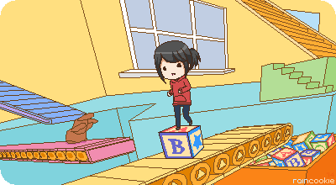

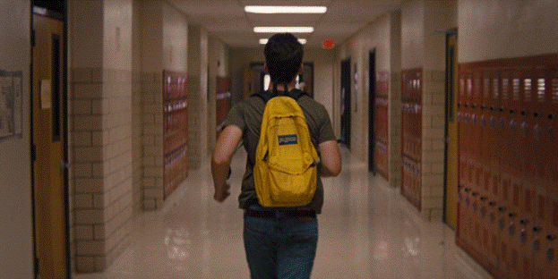
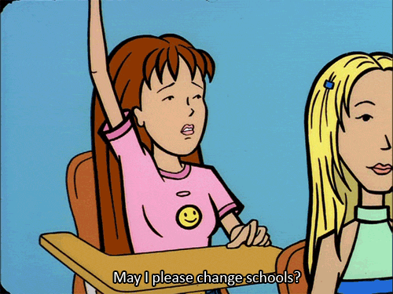

To Stop School Drop Out
Government needs to monitor the individual school year wise.
Find out the solution to solve the problem.
Financial (Child Labour)
Unknown
School Drop-out
Change The School
Medical Issue

Slide 4

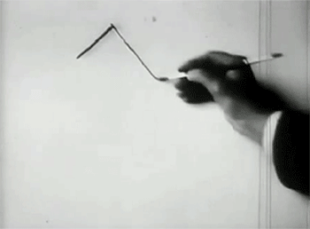
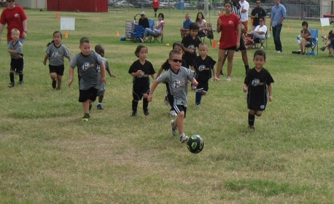

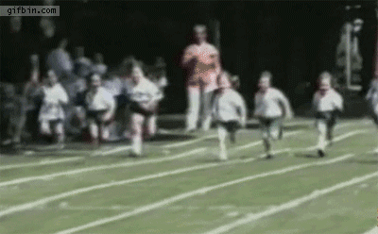

Promote The Primary Education
Academic Way
Non-Academic Way.
Drawing
Games
YOGA
Sports
Singing

Slide 5
Features:
Student aadhar as primary key of the student table
Schools will have a unique login-id after registering in the web portal
Sorting of year –wise data based on marks through standardization ( z-statistics)
Standardization can be applied for both academic and extra-curricular activities
Year-wise data can be regulated to generate the number of school drop-outs
Pi-chart is used to represent the region wise school drop-out from the state

Slide 6
Add-ons:
To generate the number of school drop-out and hence exercise control on child labor , child marriage. According to the data generated , the government can implement suitable reforms.

Slide 7
Thank You

